Slide 1

Introduction to Cloud
LECTURE -9

Slide 2
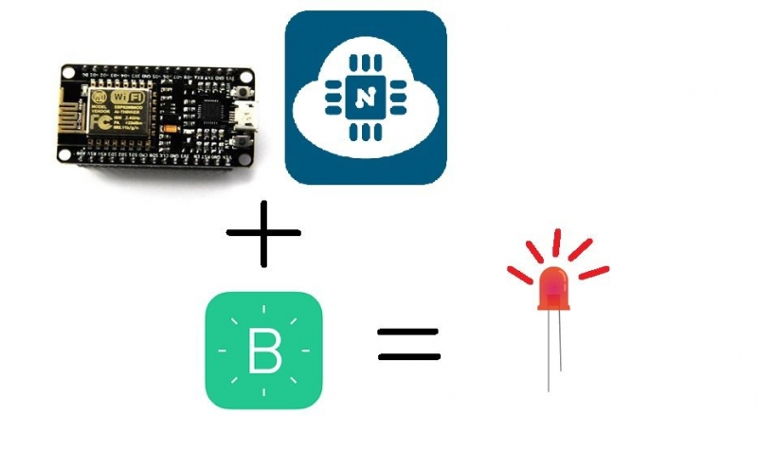
NodeMCU with Blynk LED Control

Slide 3
NodeMCU with Blynk LED Control
Components Needed:
NodeMCU
Red LED/Resistor
Smartphone with Blynk app installed
Breadboard/Jumper Wires
MicroUSB Cable
Connections:
Anode pin of the LED to the pin D7 of NodeMCU.
Cathode pin of the LED to the any GND pin of NodeMCU.
(It is recommended to do the connections after code uploading)

Slide 4
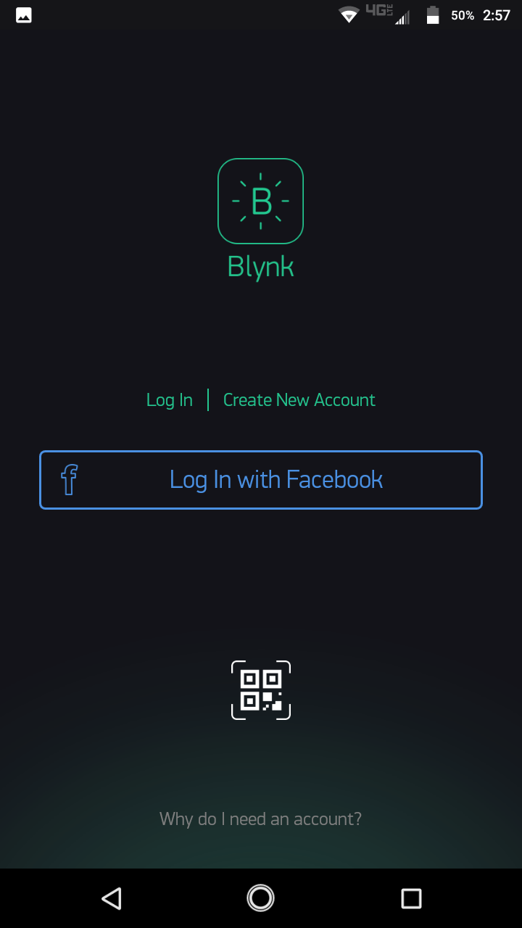
Setting Up the Blynk app
First, download the Blynk app from the playstore

Slide 5
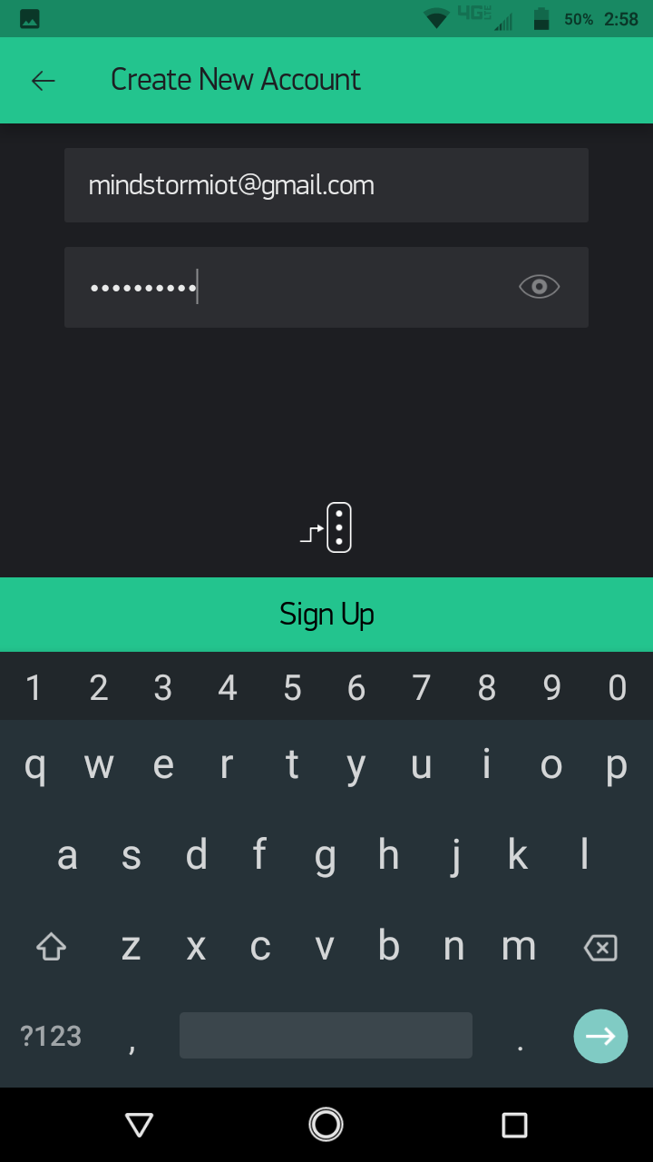
Setting Up the Blynk app
Then click on Create New Account Option and enter your email id and password, then click on Signup.

Slide 6
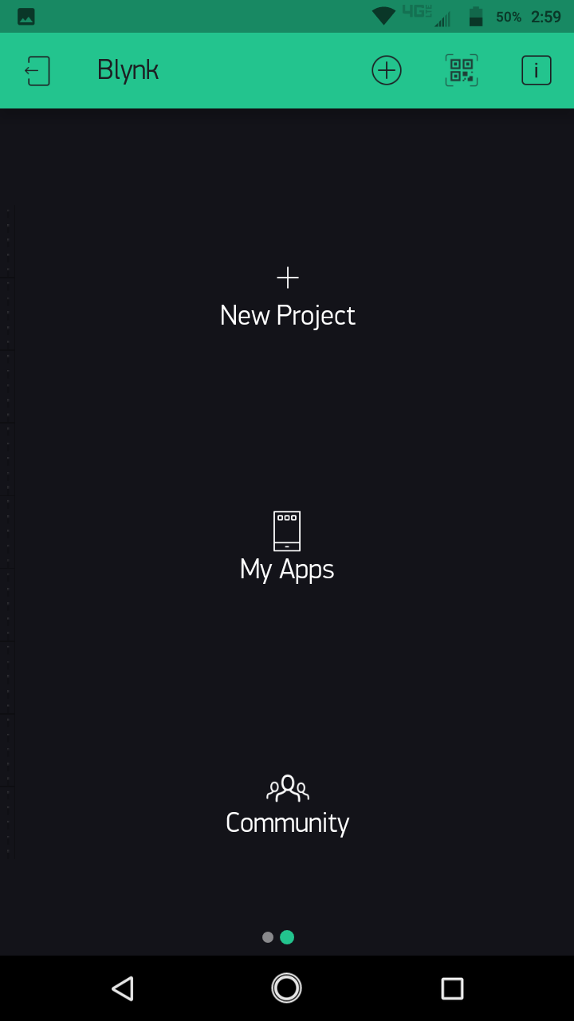
Setting Up the Blynk app
After SIgning up, click on New Project.

Slide 7
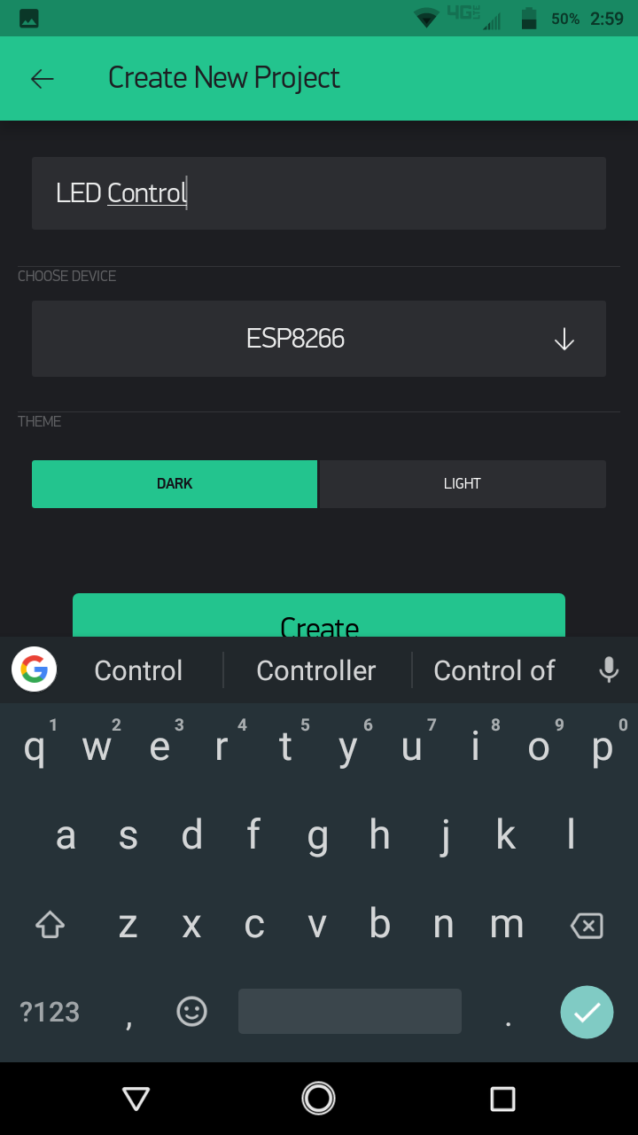
Setting Up the Blynk app
Give your project a name.

Slide 8
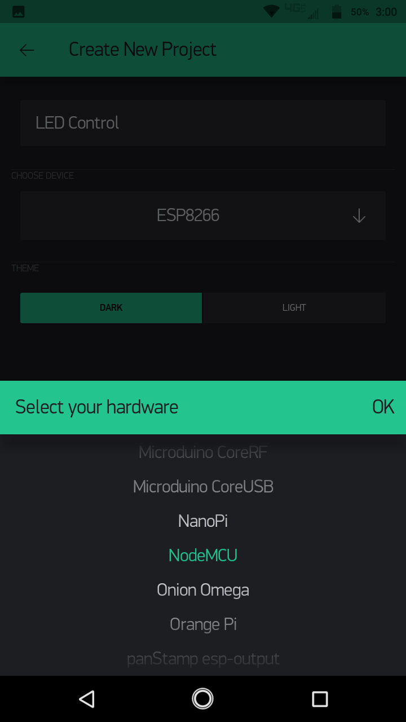
Setting Up the Blynk app
Then, under the Choose Device option, click on the Down Arrow, select NodeMCU from the list of devices and press OK. After this press Create tocreate the Project.

Slide 9
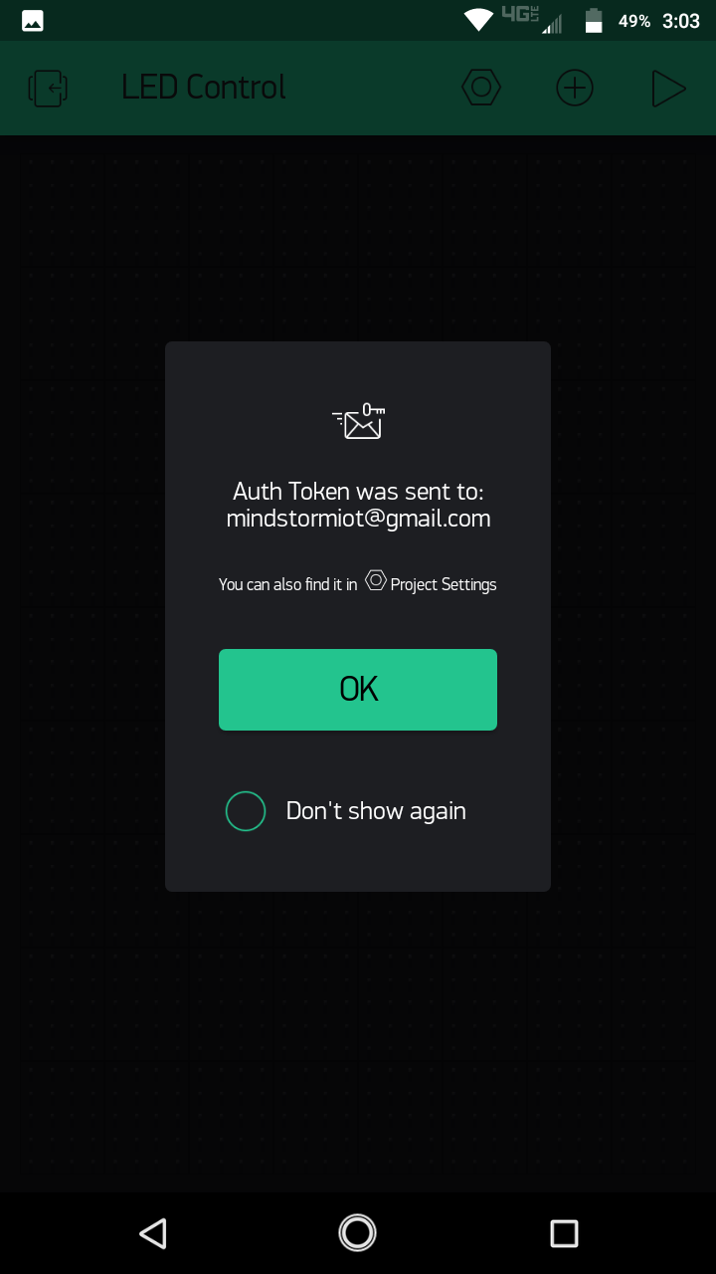
Setting Up the Blynk app
At this point, an Authentication token will be sent to your email which will be later added in the Arduino Code.

Slide 10
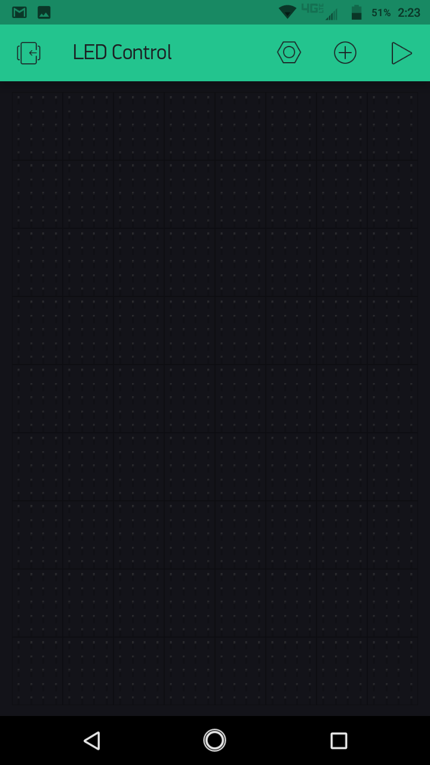
Setting Up the Blynk app
This your Project Window where all the necessary input/output components will be added.

Slide 11
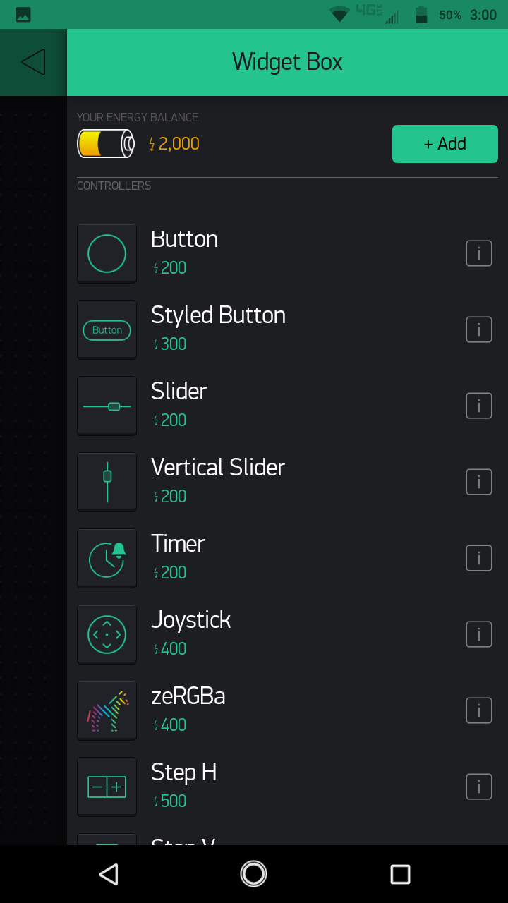
Setting Up the Blynk app
Press the circled + sign at the top right hand of you screen, this will take you to the Widget Box from where you can add different components to your project, note the Energy Balance, different widgets have different energy requirements so when you use a widget its energy will be deducted from your Energy Balance, and will be given back when you delete a widget.

Slide 12
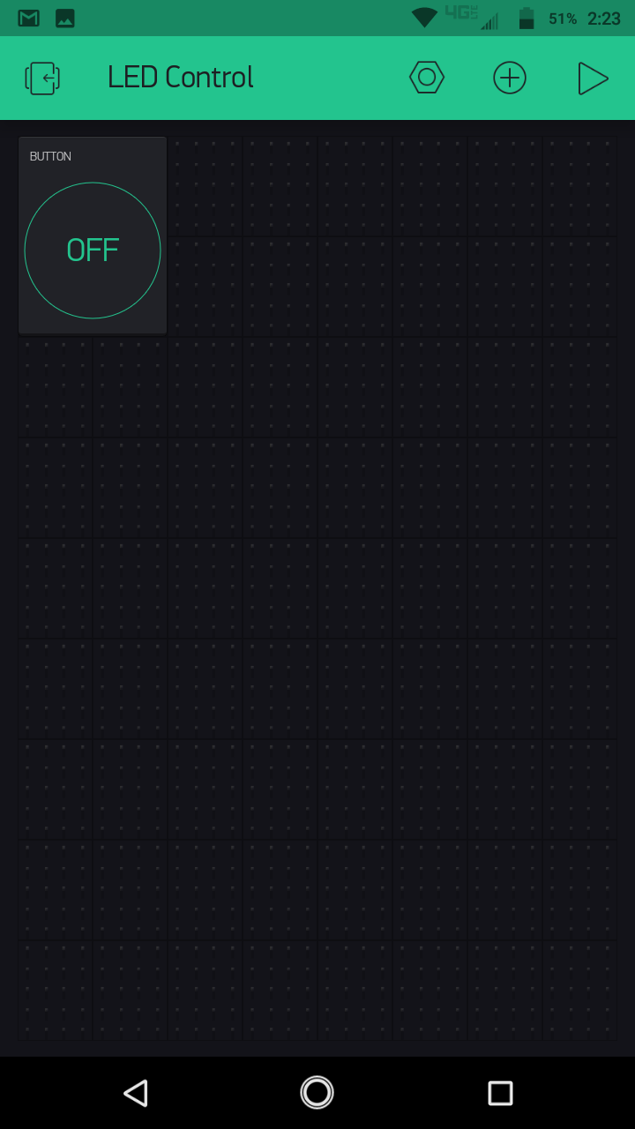
Setting Up the Blynk app
Select a button from the widget box.

Slide 13
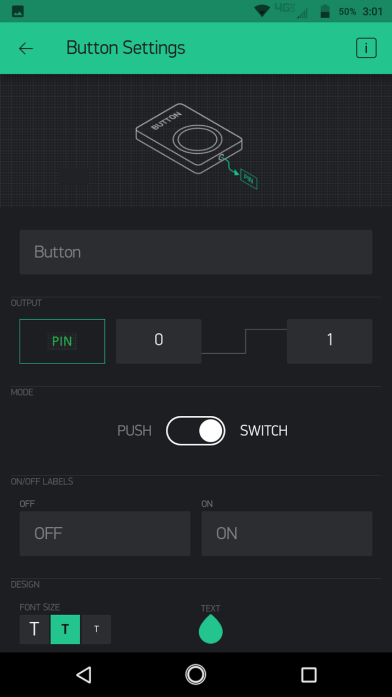
Setting Up the Blynk app
Click on that button and go to its internal Settings. You can also give a name to this button here, and you can also select what type of button this would be “Push (Momentary)” or “Switch (latched)”

Slide 14
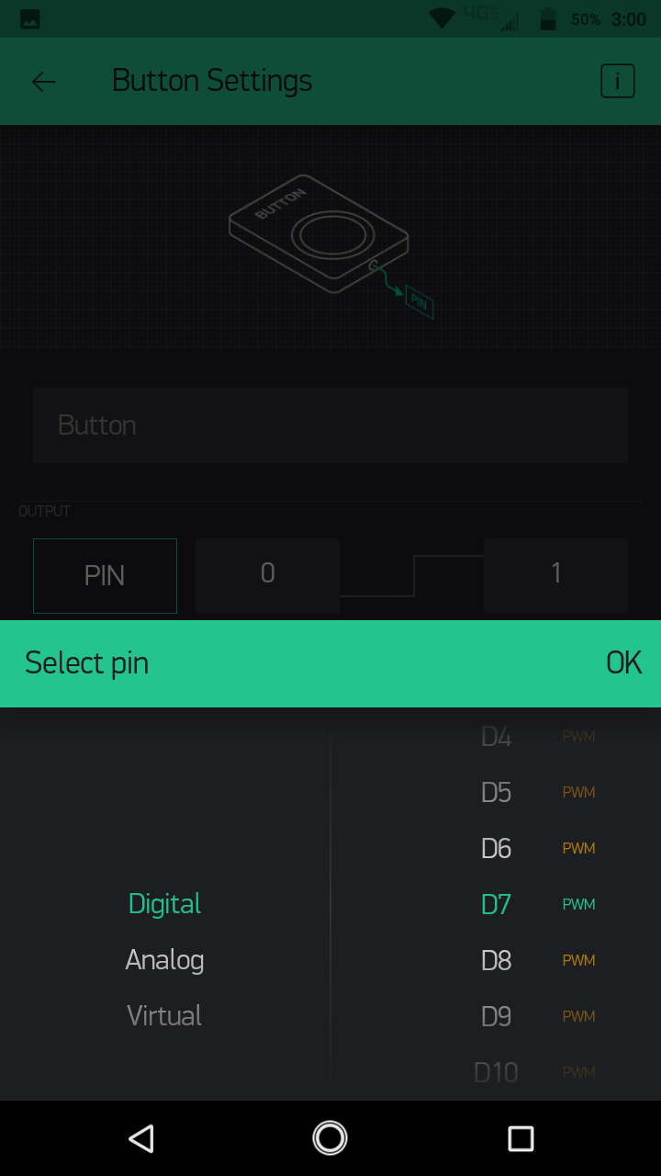
Setting Up the Blynk app
Click on the PIN option and select the pin on which your LED is connected to your NodeMCU.

Slide 15
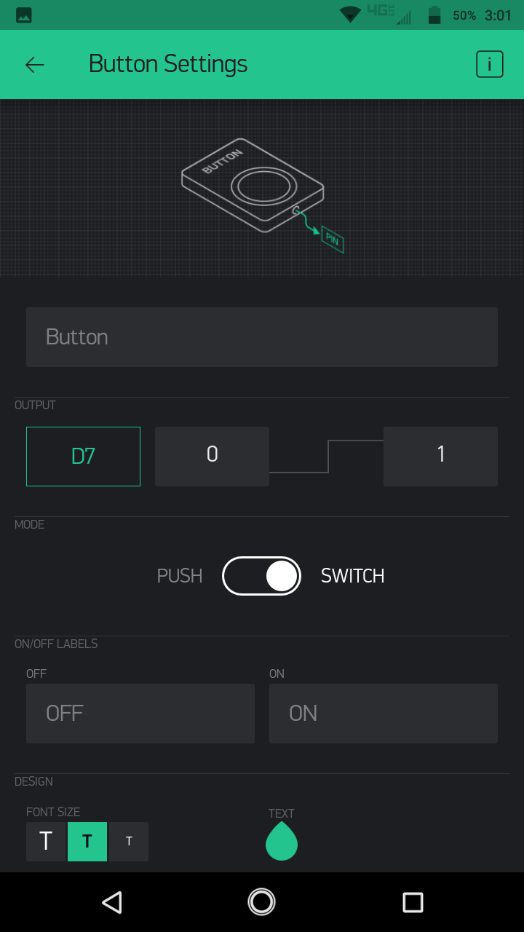
Setting Up the Blynk app
You can also select what this Blynk button would transmit when it is set to HIGH or LOW, for if you want to transmit a LOW when this Blynk button is set HIGH then swap the 1 and 0 off their places in the below picture.

Slide 16

Setting Up the Blynk app
After these settings you can press the Back Arrow Button to return to the Project Screen.

Slide 17
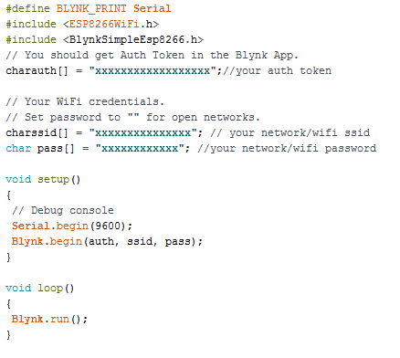
NodeMCU with blynk LED Control
Upload the following code into the NodeMCU using Arduino IDE:

Slide 18
NodeMCU with blynk LED Control
Code Explanation:
Firstly the BLYNK_PRINT Serial wiill define which serial port will be used for the Blynk Debug later in the background. Then the header file <ESP8266Wifi> will utilize all the functions needed for operating the NodeMCU over the internet. Then the header <BlynkSimpleEsp8266> is added for the working of Blynk app with the NodeMCU(Esp8266) over Wifi.
The authentication token is inserted in the code, it is required to ensure security as to make sure that the hardware connected with the PC is communicating with the correct Blynk Project and its user. Afterwards your network ssid and password are needed to establish link between the hardware and the Blynk app over your network.
In the <void setup ()> function the <Serial.begin(9600)> initializes the serial communication between your PC and the NodeMCU at a baud rate of 9600 bits per second, and the <Blynk.begin> initializes the communication between NodeMCU and Blynk. Finally, in the <void loop()> function, the <Blynk.run()> function ensures continuous communication between the Blynk app and the NodeMCU.
Result:
After the connections have been made, the Blynk app has been setup and the Code has been uploaded, then open the Blynk app and press the play button. Now when you press the button on the (LED Control) Project Area, then the LED connected with NodeMCU should turn on and when you press it again, the LED should turn off.

Slide 19
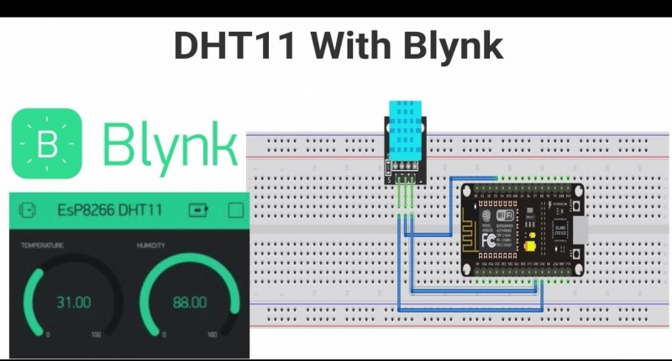
NodeMCU with Blynk Weather Monitoring

Slide 20
NodeMCU with Blynk Weather Monitoring
Components Needed:
NodeMCU
DHT11 Temperature and Humidity Sensor
Smartphone with Blynk app installed
Breadboard/Jumper Wires
MicroUSB Cable
Connections:
The first pin from the left (VCC) of the DHT11 is connected to any 3V pin of the NodeMCU.
The second pin from the left (OUTPUT) of the DHT11 is connected to D4 pin of the NodeMCU.
The third pin is left unconnected.
The fourth pin (GND) of the DHT11 is connected to any GND pin of the NodeMCU.
(It is recommended to do the connections after code uploading)

Slide 21
Setting Up the Blynk app
To know about the Basic Setup of the Blynk app, see the previous lesson NodeMCU with Blynk-LED Control.

Slide 22
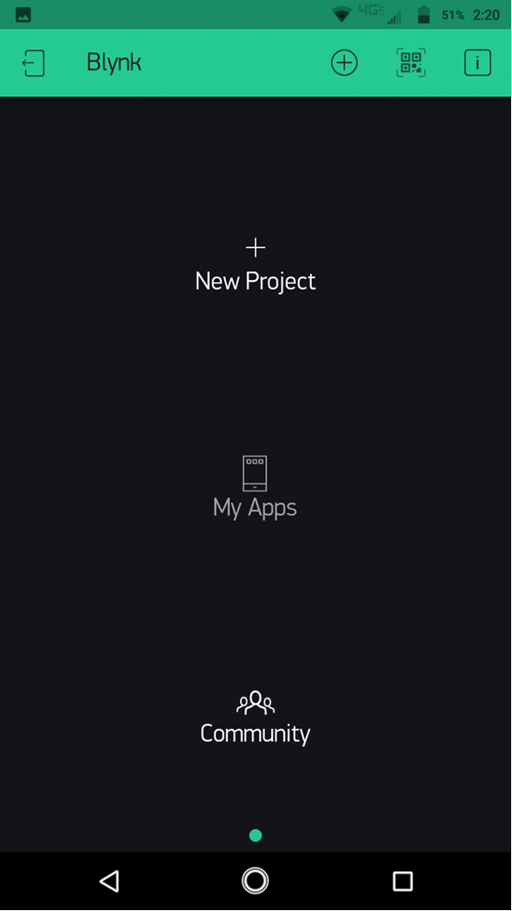
Setting Up the Blynk app
After the Basic setup is done, go to New Project

Slide 23
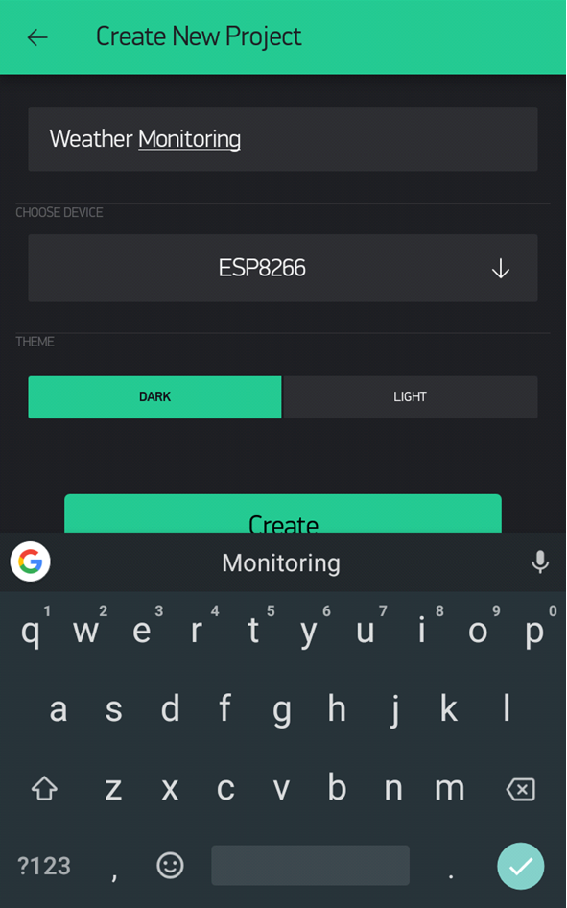
Setting Up the Blynk app
Give your project a name.

Slide 24
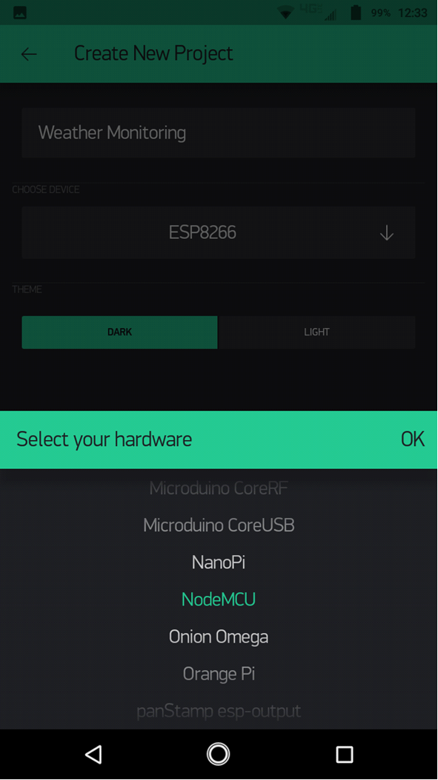
Setting Up the Blynk app
Select NodeMCU in the Device Option.

Slide 25
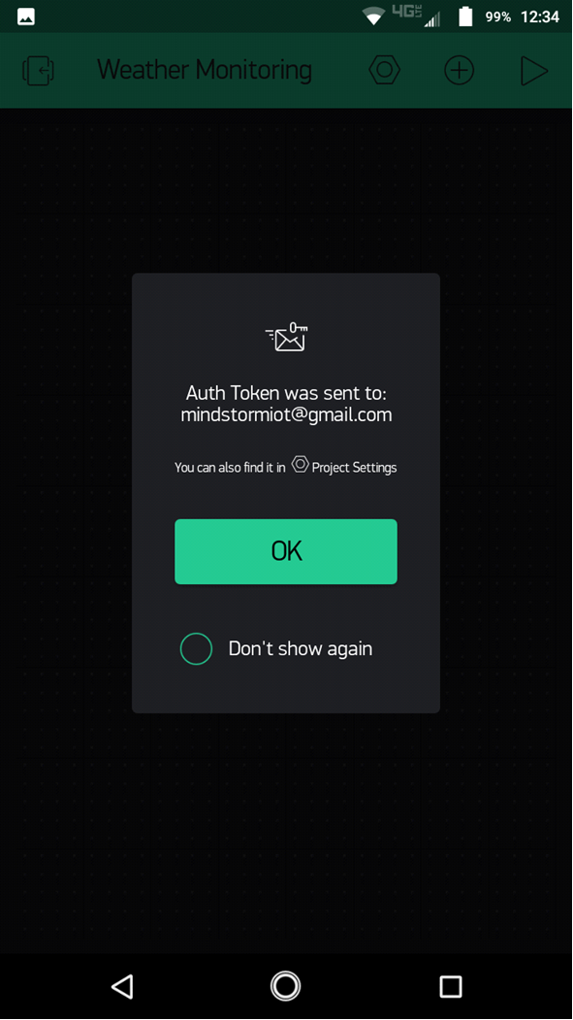
Setting Up the Blynk app
Then an auth token will be sent to your email, you will need this token later in the Arduino Coding.

Slide 26
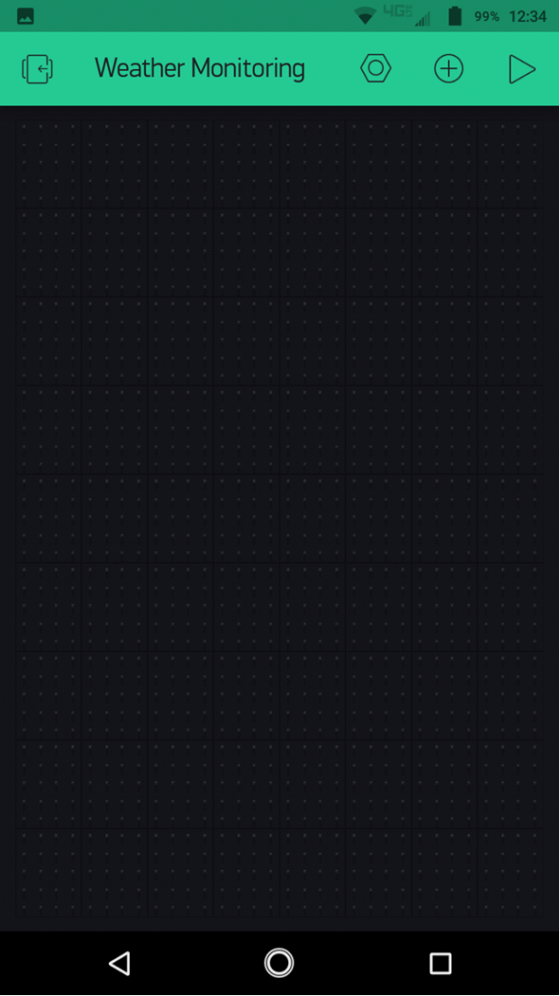
Setting Up the Blynk app
By clicking ok, you will reach your project window.

Slide 27
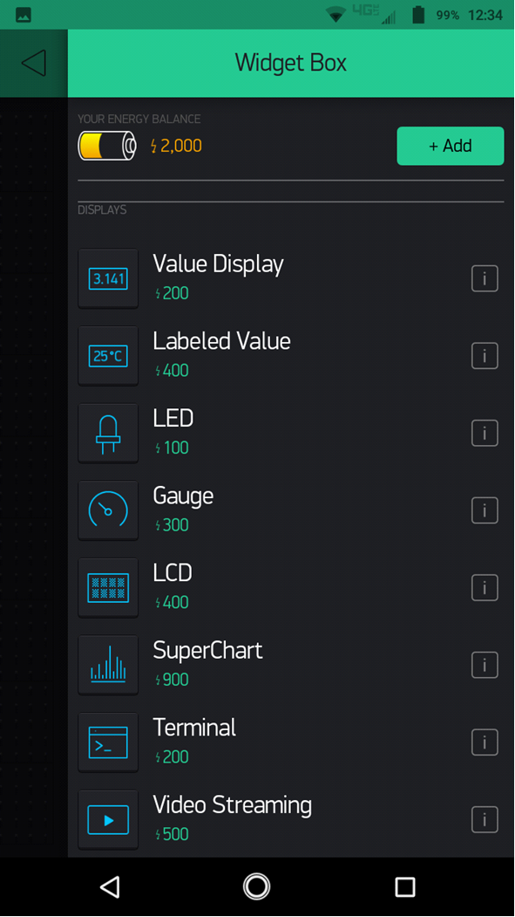
Setting Up the Blynk app
Click on the Circled + sign and go to the Widget box, and select a Gauge.

Slide 28
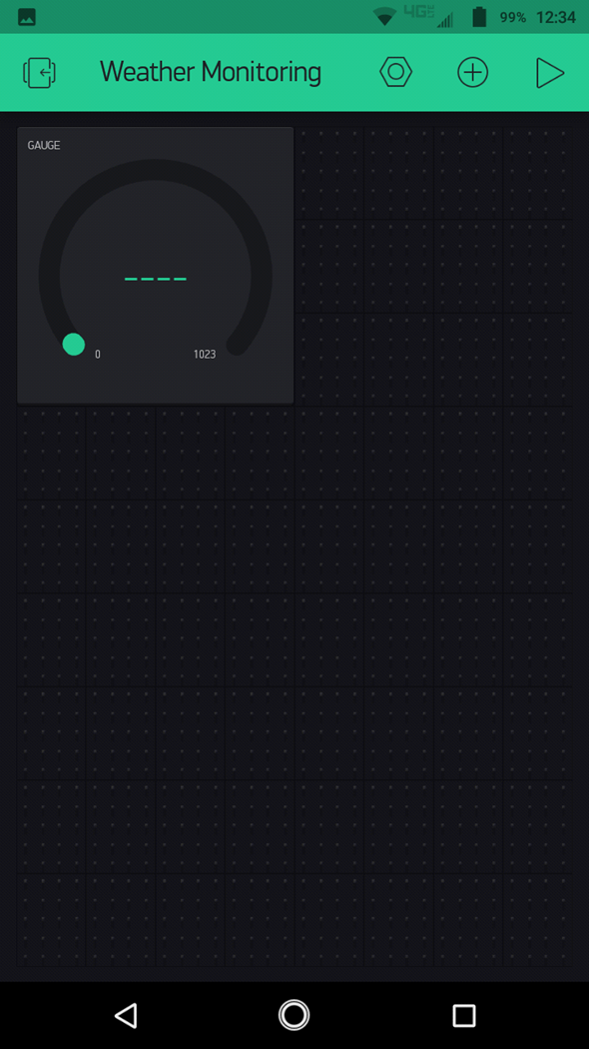
Setting Up the Blynk app
This is the gauge you selected.

Slide 29
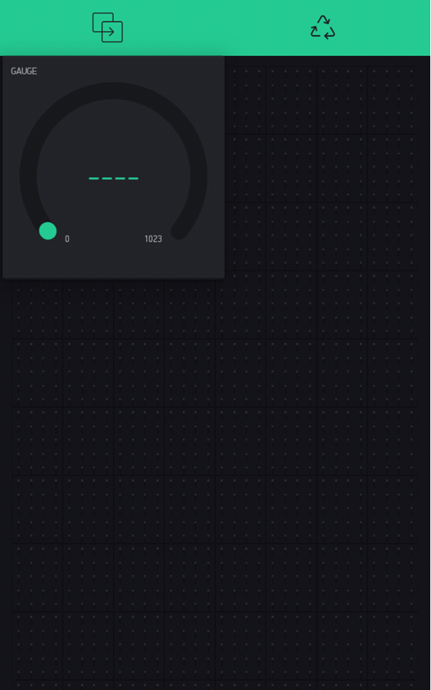
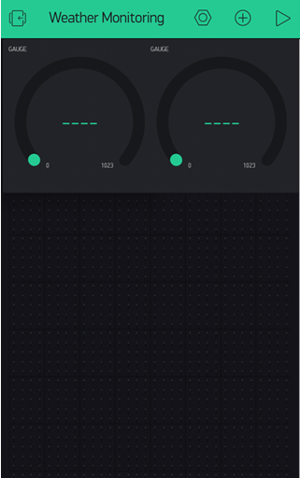
Setting Up the Blynk app
Press and hold the gauge, hover it upwards and drop it to the Copy sign to make another gauge.

Slide 30
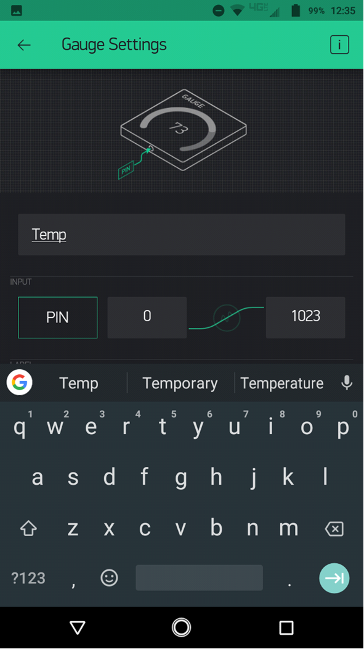
Setting Up the Blynk app
Now click on the first gauge and give it a name.

Slide 31
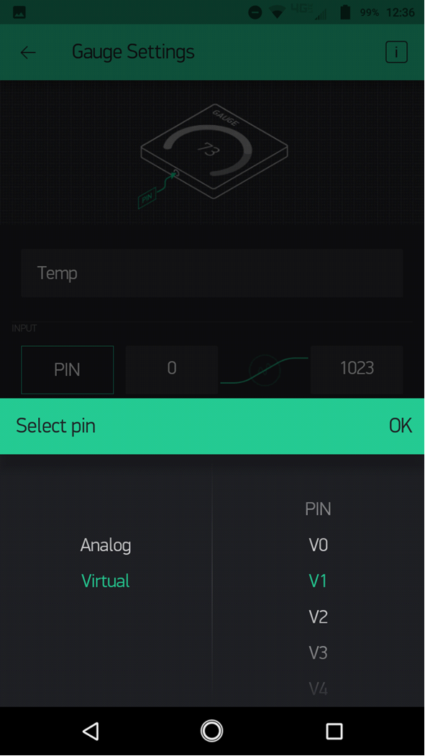
Setting Up the Blynk app
Then Click on the PIN and Set it to Virtual V1.

Slide 32
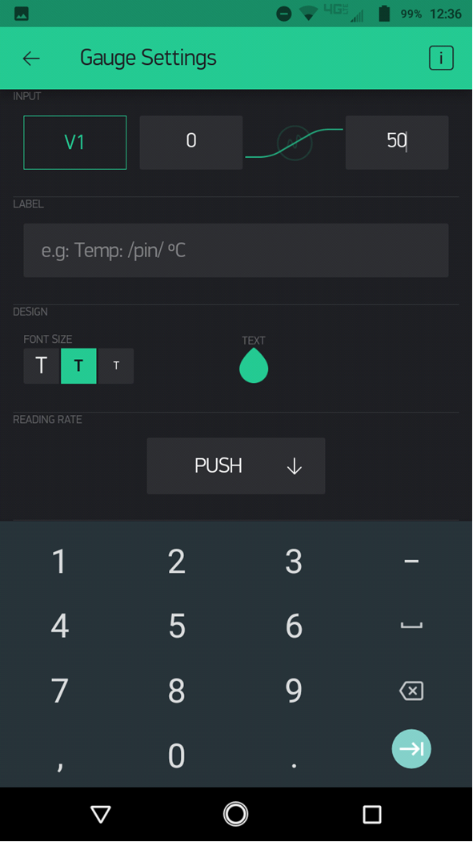
Setting Up the Blynk app
Then set its range from 0 to 50.

Slide 33
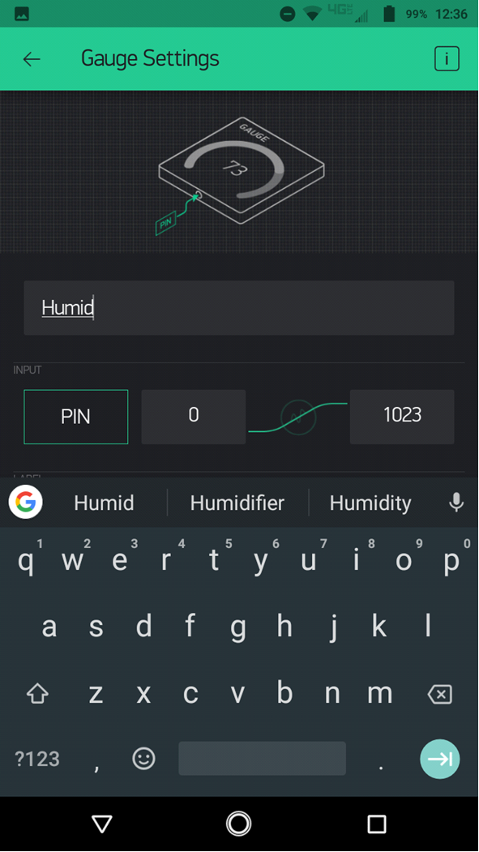
Setting Up the Blynk app
After click the OK/arrow sign, get back to the Project Window and Click on the second gauge and Set its name to Humid.

Slide 34
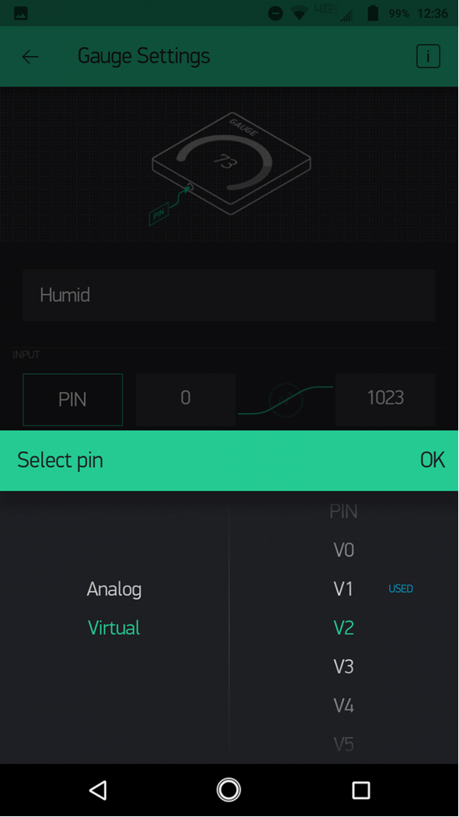
Setting Up the Blynk app
Set its PIN to Virtual V2.

Slide 35

Setting Up the Blynk app
Set its range from 0 to 100.

Slide 36
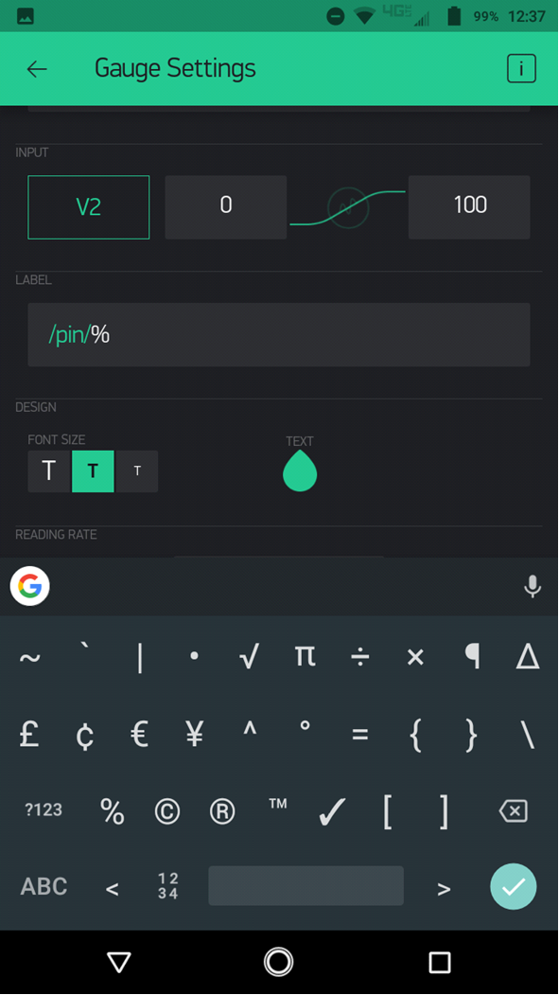
Setting Up the Blynk app
And set its label to %.

Slide 37
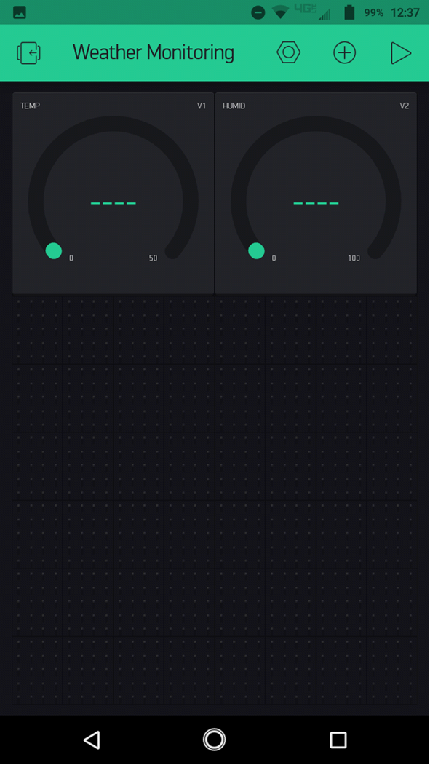
Setting Up the Blynk app
By Clicking ok/arrow sign go back to the Project Window.

Slide 38
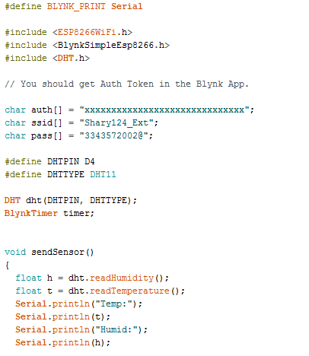
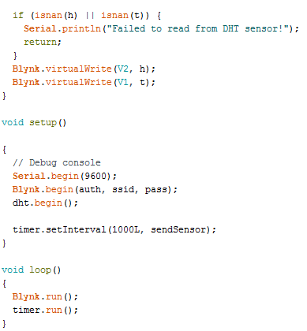
NodeMCU with Blynk Weather Monitoring
Upload the following code into the NodeMCU using Arduino IDE:

Slide 39
NodeMCU with Blynk Weather Monitoring
Code Explanation:
Firstly the BLYNK_PRINT Serial wiill define which serial port will be used for the Blynk Debug later in the background. Then the header file <ESP8266Wifi> will utilize all the functions needed for operating the NodeMCU over the internet. Then the header <BlynkSimpleEsp8266> is added for the working of Blynk app with the NodeMCU(Esp8266) over Wifi. Finally the header file <DHT> is added to utilize all the files necessary for interfacing DHT11 with the NodeMCU.
Afterwards, the Network credentials are added so that the Wifi link between the Blynk app and the NodeMCU can be established. The BlynkTimer will be used with timer.setInterval later to decide that on what intervals the measured temperature and humiidity values are to be communicated.
The later part of the Temperature and Humidity Sensing code (some part of itt enclosed in the SendSensor function) is explained in the earlier DHT11 Lab. The Blynk.virtualWrite functions will communicate the measured values of temperature and humidity from the NodeMCU to the Blynlk app on the smartphone.
In the void setup() function the serial communication between the PC and the NodeMCU is initialized at a baudrate of 9600 bit per second. The Blynk.begin function will initialize the communication between the Blynk app and the NodeMCU. The dht.begin(); initiates the communication between the DHT11 sensor and the NodeMCU.
Finally In the void loop() function, the Blynk.run will start the value sending process to the Blynk app and the timer will give the set timer interval in between.

Slide 40
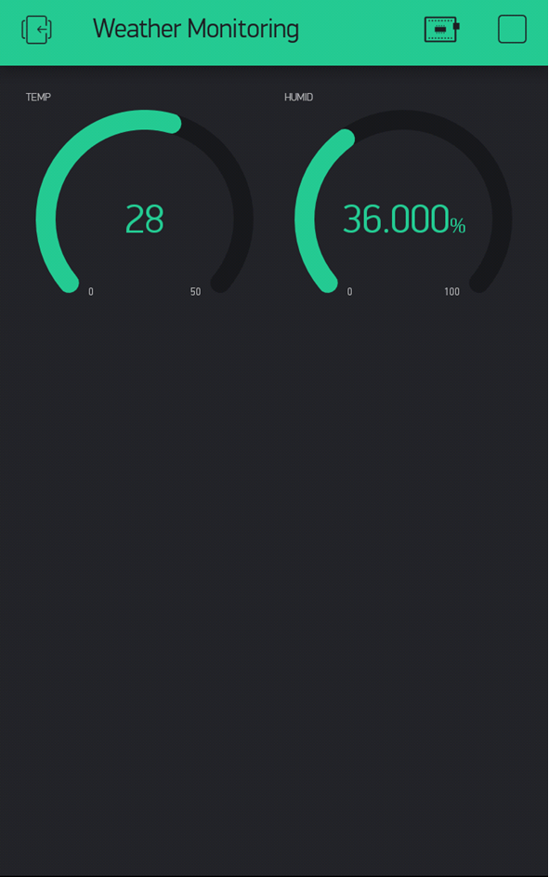
NodeMCU with Blynk Weather Monitoring
Result: After the connections are made according to the given figure,theBlynk app is setup and the code is uploaded into the NodeMCU, then go tho the Blynk app and press the play button. The temperature and the humidity reading will be shown as below.

Slide 41
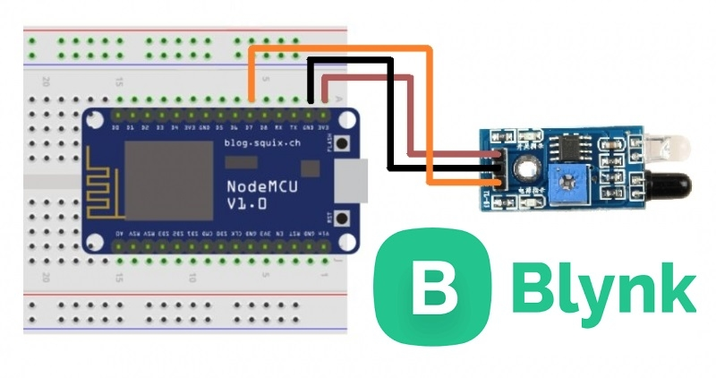
NodeMCU with Blynk IR sensor

Slide 42
NodeMCU with Blynk IR sensor
Components Needed:
NodeMCU
Smartphone with Blynk app installed
IR Sensor
MicroUSB Cable
Breadboard/Jumper Wires
Connections:
VCC Pin of IR Module is connected to any 3V pin of the NodeMCU.
GND Pin of IR Module is connected to any GND pin of the NodeMCU.
OUTPUT Pin of IR Module is connected to D7 pin of the NodeMCU.
(It is recommended to do the connections after code uploading)

Slide 43
Setting Up the Blynk app
To know about the Basic Setup of the Blynk app, see the first lesson NodeMCU with Blynk-LED Control.

Slide 44
Setting Up the Blynk app
Go to New Project and give your project a name and select NodeMCU board and create.

Slide 45
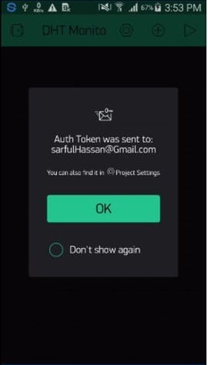
Setting Up the Blynk app
Here you got your AUTH TOKEN sent to your email address. Press OK

Slide 46
Setting Up the Blynk app
Now you can see your Interface like this.

Slide 47
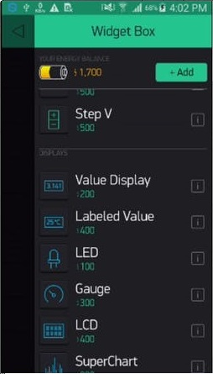
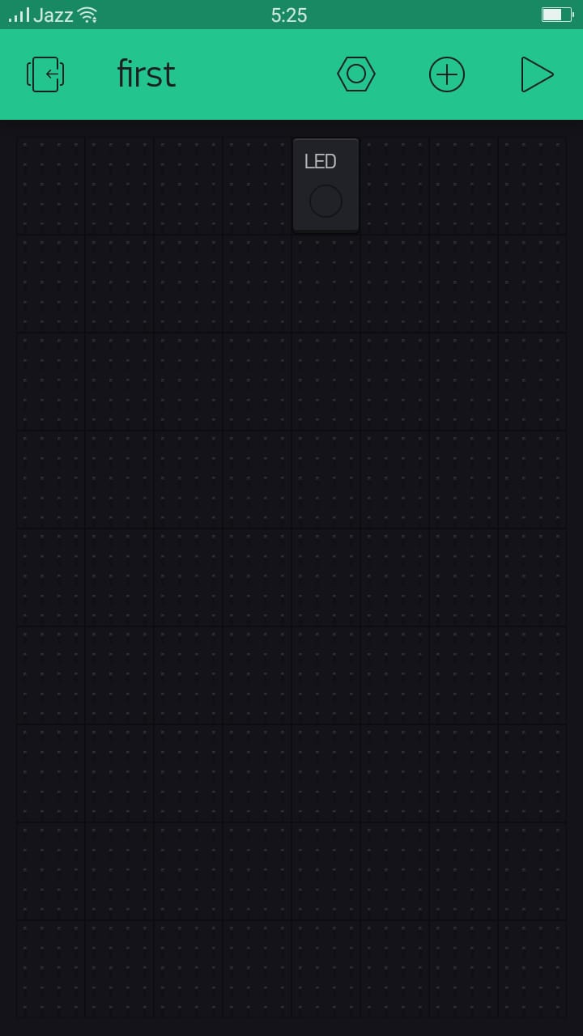
Setting Up the Blynk app
Now go to Widget Box And select LED.

Slide 48
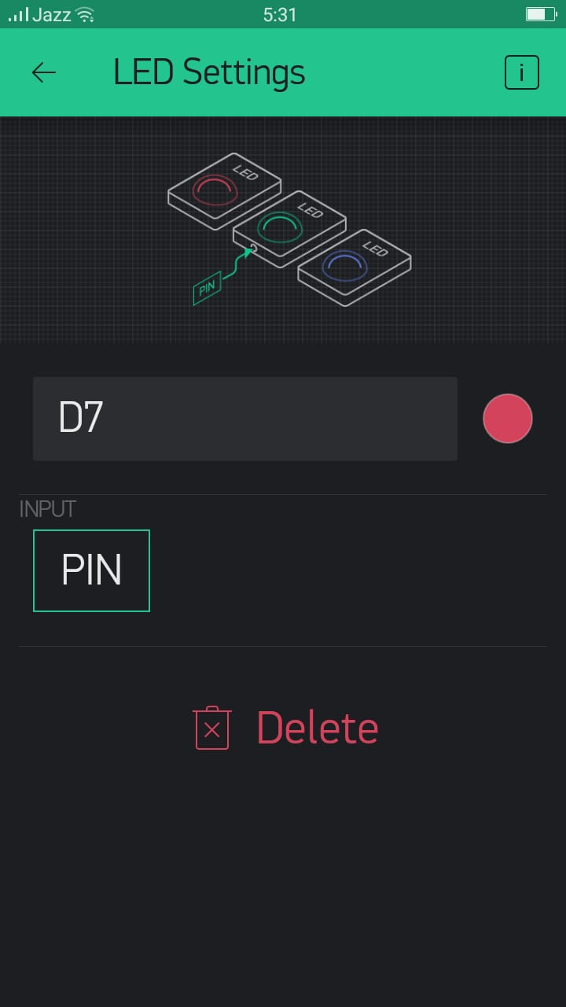
Setting Up the Blynk app
Select LED for settings, Select D7 for pin

Slide 49
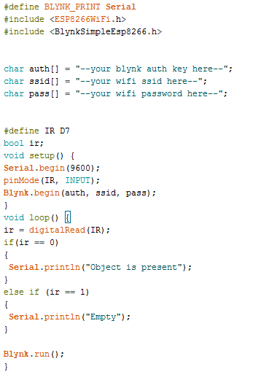
NodeMCU with Blynk IR SENSOR
Upload the following code into the NodeMCU using Arduino IDE:

Slide 50
NodeMCU with Blynk Ir sensor
Code Explanation:
Firstly the BLYNK_PRINT Serial wiill define which serial port will be used for the Blynk Debug later in the background. Then the header file <ESP8266Wifi> will utilize all the functions needed for operating the NodeMCU over the internet. Then the header <BlynkSimpleEsp8266> is added for the working of Blynk app with the NodeMCU(Esp8266) over Wifi.
Then, the authentication token is inserted in the code, it is required to ensure security Afterwards your network credentials (ssid and password) are needed to establish link between the hardware and the Blynk app over your network. Using the <#define IR D7> statement, the pin D7 of the NodeMCU was defined as the IR pin where the output pin of the IR module would be connected.
After that variable "ir" is defined with the "bool" data type (since it will be used later in the code for reading the output of the IR module which can be either HIGH "1" or LOW "0").
Then in the <void setup()> function, the serial communication between the PC and NodeMCU is initiated with a baud rate of 9600 bit per second using <Serial.begin(9600)>, and the mode for the IR pin is set to INPUT using <pinMode> statement because the IR pin would take the output of the IR module as input to the NodeMCU.
Finally in the <void loop()> function, IR pin is digitally read and its value is stored in the "ir" variable, if its value is equal (==) to 1 [i.e an object is in front of the IR module's detection range] then "Object is Present" is printed on the Arduino serial monitor, if it is 0, then "Empty" is printed on the Arduino Serial monitor. The <Blynk.run()> function ensures continuous communication between the Blynk app and the NodeMCU.Finally In the void loop() function, the Blynk.run will start the value sending process to the Blynk app and the timer will give the set timer interval in between.

Slide 51
NodeMCU with Blynk ir sensor
Result: After the connections are made according to the given figure,the Blynk app is setup and the code is uploaded into the NodeMCU, then go tho the Blynk app and press the play button. See how IR Sensor detects objects in front of it, state of IR sensor can also be seen remotely through blynk app.

Slide 52
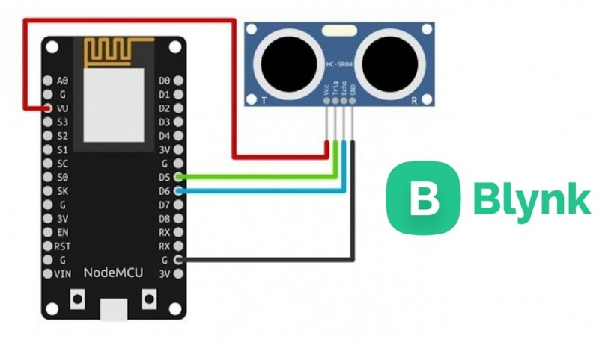
NodeMCU with Blynk ULTRAsonic sensor

Slide 53
NodeMCU with Blynk ULTRASONIC sensor
Components Needed:
NodeMCU
Smartphone with Blynk app installed
Ultrasonic Sensor
MicroUSB Cable
Breadboard/Jumper Wires
Connections:
VCC Pin of IR Module is connected to any 3V pin of the NodeMCU.
GND Pin of IR Module is connected to any GND pin of the NodeMCU.
OUTPUT Pin of IR Module is connected to D7 pin of the NodeMCU.
(It is recommended to do the connections after code uploading)

